Slide 1

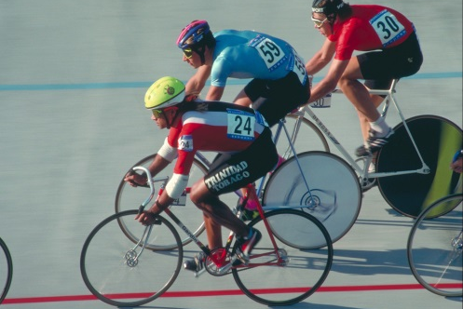

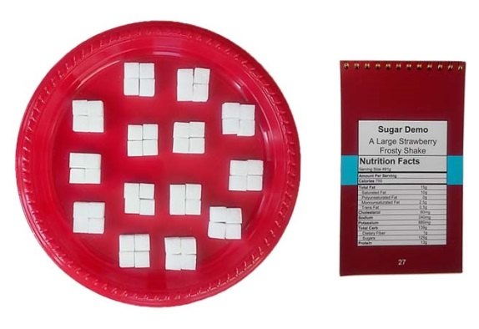

Added & Hidden Sugar
Education Workshop
www.SugarDemo.org

Slide 2
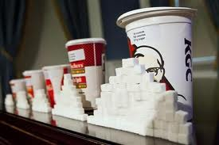
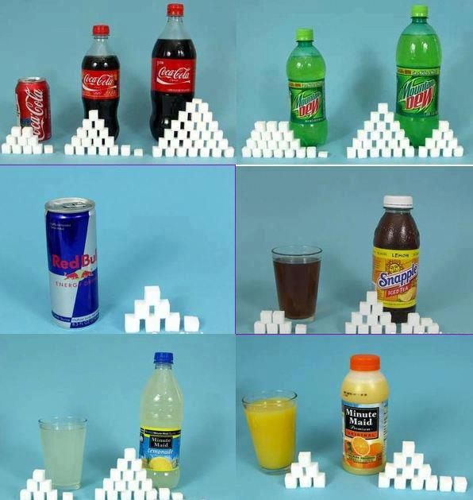
Does everybody like sweets?
Can we have as much the sweet as we want every day?
What make it sweet in beverages and processed food?
Do we know how much sugars we eat and drink every day?
Added sugars are hidden in beverages and processed foods.

Slide 3



Added sugars are linked to diabetes.
Added sugars are linked to obesity.

Slide 4


Overeating sugar is linked to cancers.
Overeating sugars leads to many diseases, maybe not happen now, but later in our lives.

Slide 5
Why overconsumption of sugars is bad for us
Added sugars are directly absorbed into blood stream instantly, impacting our body sugar balance.
Large doses of blood sugar enter our liver, where the sugar is turned into fat (Triglyceride) and stored in our bodies.
Sugar is addictive and toxic. Overconsumption is considered harmful to our health next to smoking cigarettes.

Slide 6


Sugar Demo Kit contains:
1 carrying case
3 nutrition fact card booklets
3 posters
1 sheets of six stickers
4 colored plates
1 box of sugar cubes (each cube is 2 grams)
3 daily sugar count forms
One booklet of nutrition fact cards
contains:
22 cards for typical beverages
22 cards for typical foods

Slide 7
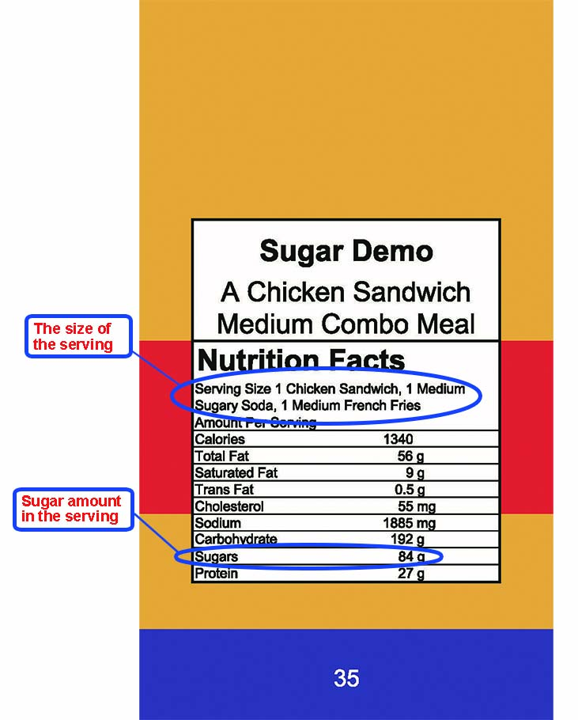
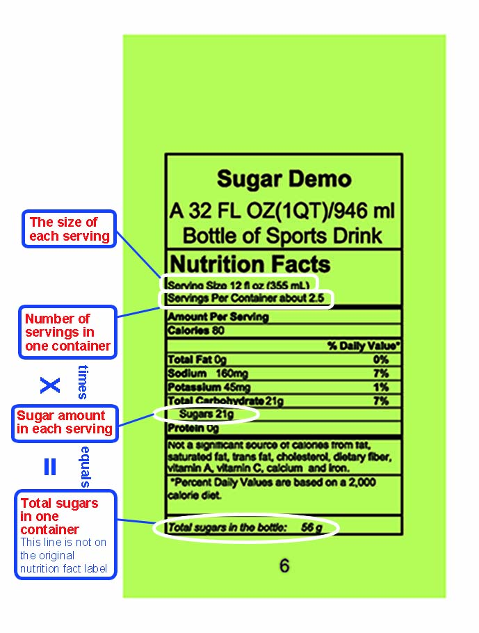
Reading Nutrition Facts
One Serving
Multiple Servings

Slide 8
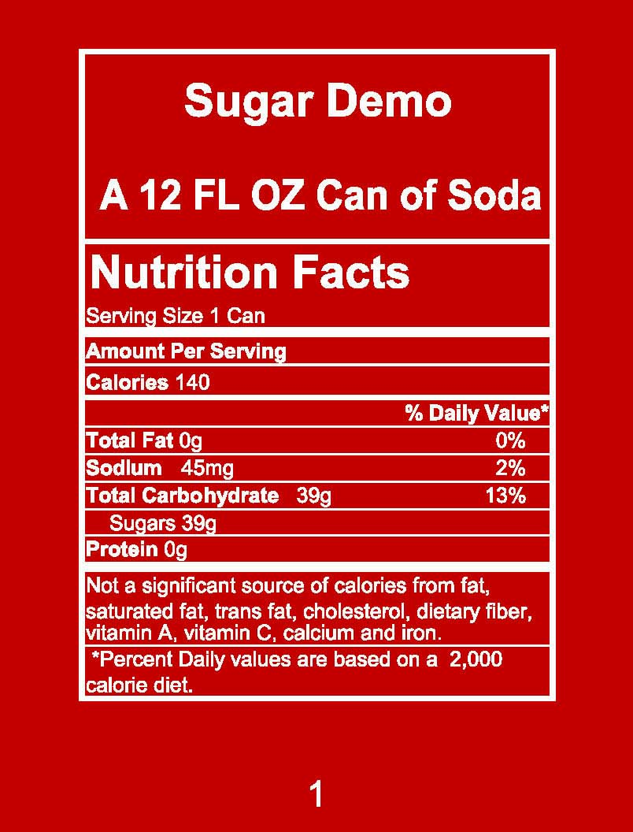

Single Serving Demo Procedures
1. Read nutrition information of the food or
beverage the card represents.
2. Read the number of grams of sugars.
3. Divide the number of grams by 2 is the
number of cubes. (Each cube is 2 grams)
4. Put the amount of sugar cubes on a plate
and put them in order.
5. Count and visualize the amount of sugars.

Slide 9
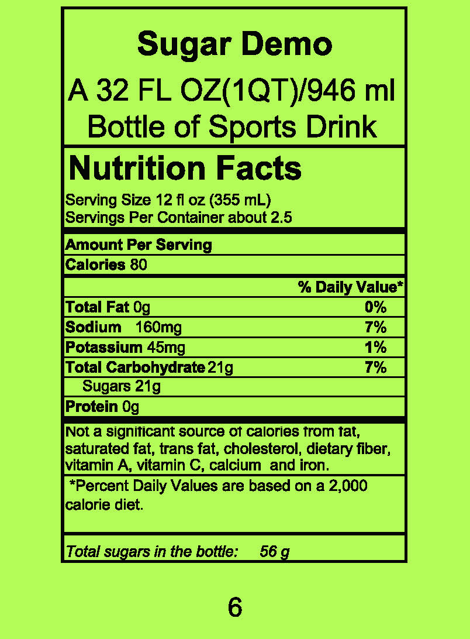

Demo Procedures for Multiple Servings
1. Choose a Sugar Demo nutrition fact card
with multiple servings
2. Total the amount of sugars by multiplying
number of servings and number of grams
in each serving.
3. Dividing the total amount of sugars in
grams by 2 (each sugar cube is 2 grams) is
the number of cubes.
4. Put the sugar cubes on a plate and array
in order.
5. Count and visualize the amount of sugars.

Slide 10
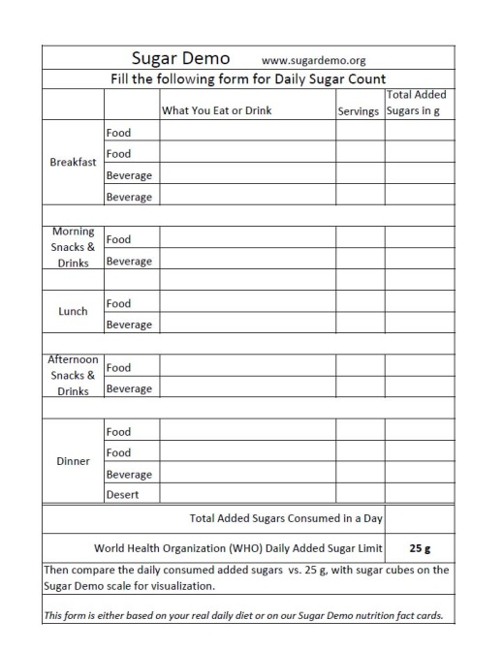

Daily added Sugar Count Form
1. Fill out the form with the amount of added
sugars in foods and drinks you consume daily.
2. Summarize the total amount of added sugars.
3. Compare the total added sugar intake vs. the
daily added sugar limit as shown below.
The World Health Organization (W.H.O.) recommends intake less than 25 grams of added sugar each day.

Slide 11

Videos
Drinking vs. Eating Sugars
https://www.youtube.com/watch?v=6kgIctvwCqw
Sugar is killing us
https://www.youtube.com/watch?v=Yda8RtOcVFU

Slide 12
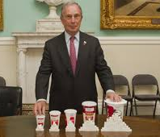
Thanks for your participation in the workshop!
If only one person actually learns from the demo today, our time and efforts are well worth it. How’s everybody?

